Slide 1
Network Address Translation (NAT)
Computer Networks
Dr. Muhammad Nadeem Majeed

Slide 2
Private Network
Private IP network is an IP network that is not directly connected to the Internet
IP addresses in a private network can be assigned arbitrarily.
  Not registered and not guaranteed to be globally unique
Generally, private networks use addresses from the following experimental address ranges (non-routable addresses):
  10.0.0.0 – 10.255.255.255
  172.16.0.0 – 172.31.255.255
  192.168.0.0 – 192.168.255.255

Slide 3
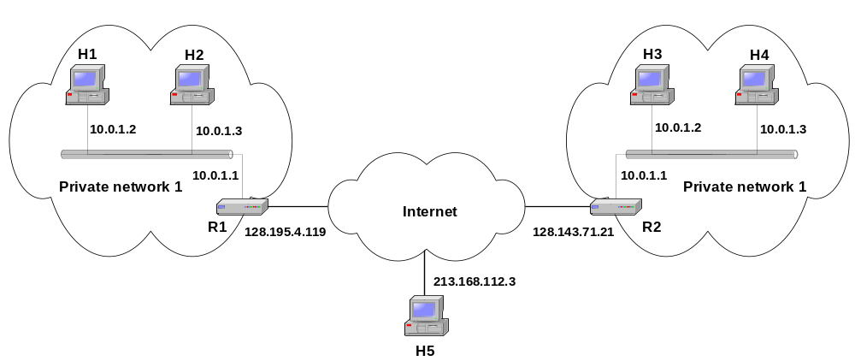
Private Addresses

Slide 4
Network Address Translation (NAT)
NAT is a router function where IP addresses (and possibly port numbers) of IP datagrams are replaced at the boundary of a private network
NAT is a method that enables hosts on private networks to communicate with hosts on the Internet
NAT is run on routers that connect private networks to the public Internet, to replace the IP address-port pair of an IP packet with another IP address-port pair.

Slide 5
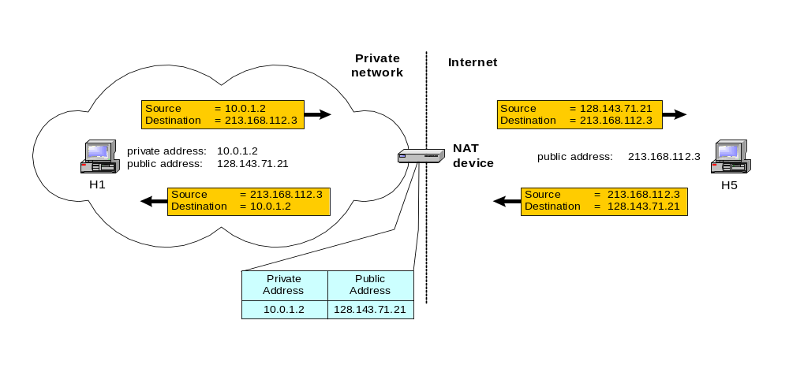
Basic operation of NAT
NAT device has address translation table

Slide 6
Pooling of IP addresses
Scenario: Corporate network has many hosts but only a small number of public IP addresses
NAT solution:
  Corporate network is managed with a private address space
  NAT device, located at the boundary between the corporate network and the public Internet, manages a pool of public IP addresses
  When a host from the corporate network sends an IP datagram to a host in the public Internet, the NAT device picks a public IP address from the address pool, and binds this address to the private address of the host

Slide 7
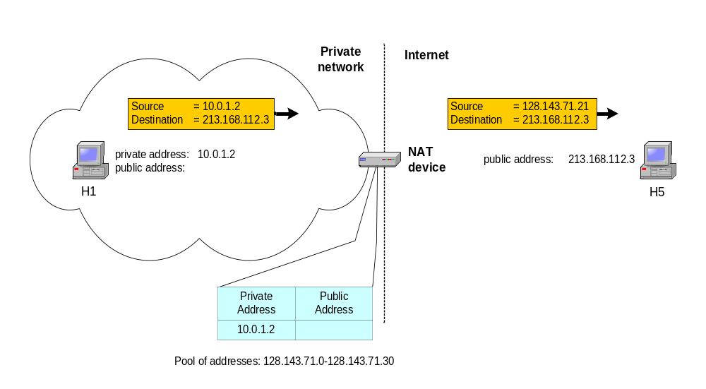
Pooling of IP addresses

Slide 8
Supporting migration between network service providers
Scenario: In CIDR, the IP addresses in a corporate network are obtained from the service provider. Changing the service provider requires changing all IP addresses in the network.
NAT solution:
  Assign private addresses to the hosts of the corporate network
  NAT device has static address translation entries which bind the private address of a host to the public address.
  Migration to a new network service provider merely requires an update of the NAT device. The migration is not noticeable to the hosts on the network.
  Note:
  The difference to the use of NAT with IP address pooling is that the mapping of public and private IP addresses is static.

Slide 9
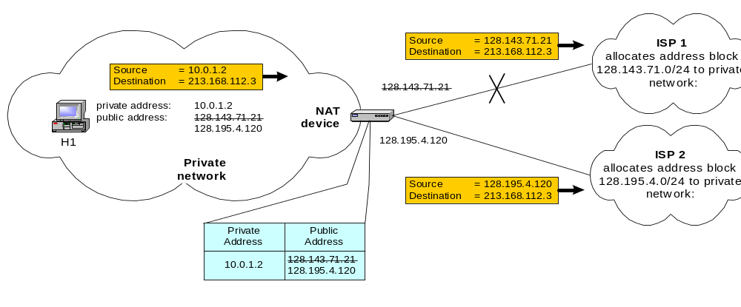
Supporting migration between network service providers

Slide 10
IP masquerading
Also called: Network address and port translation (NAPT), port address translation (PAT).
Scenario: Single public IP address is mapped to multiple hosts in a private network.
NAT solution:
  Assign private addresses to the hosts of the corporate network
  NAT device modifies the port numbers for outgoing traffic

Slide 11
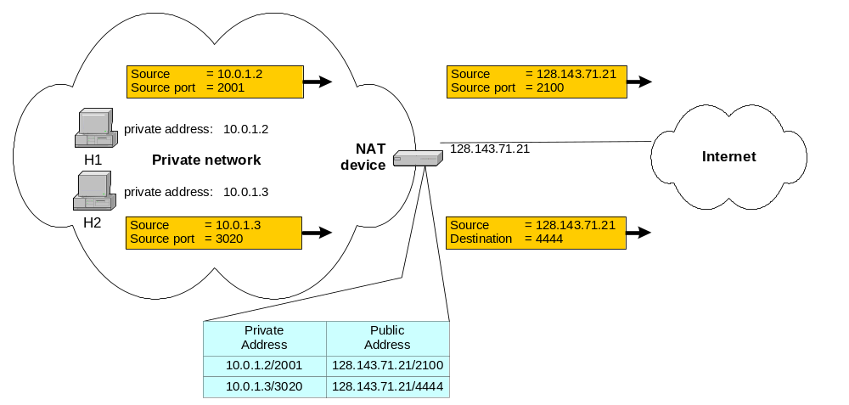
IP masquerading

Slide 12
Load balancing of servers
Scenario: Balance the load on a set of identical servers, which are accessible from a single IP address
NAT solution:
  Here, the servers are assigned private addresses
  NAT device acts as a proxy for requests to the server from the public network
  The NAT device changes the destination IP address of arriving packets to one of the private addresses for a server
  A sensible strategy for balancing the load of the servers is to assign the addresses of the servers in a round-robin fashion.

Slide 13
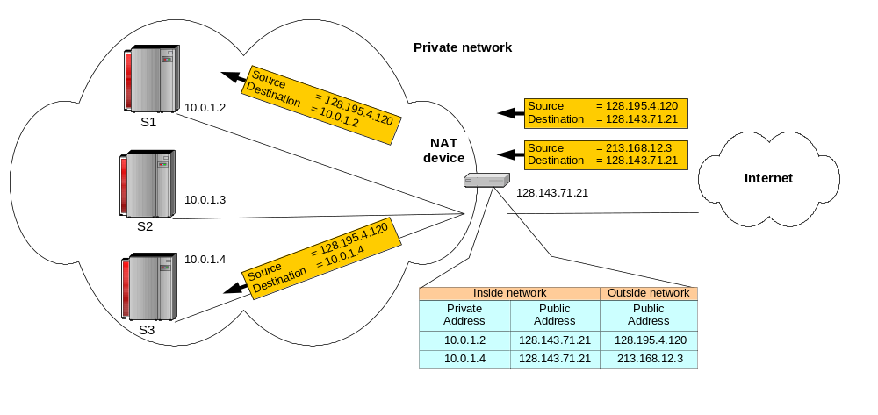
Load balancing of servers

Slide 14
Concerns about NAT
Performance:
  Modifying the IP header by changing the IP address requires that NAT boxes recalculate the IP header checksum
  Modifying port number requires that NAT boxes recalculate TCP checksum
Fragmentation
  Care must be taken that a datagram that is fragmented before it reaches the NAT device, is not assigned a different IP address or different port numbers for each of the fragments.

Slide 15
Concerns about NAT
End-to-end connectivity:
  NAT destroys universal end-to-end reachability of hosts on the Internet.
  A host in the public Internet often cannot initiate communication to a host in a private network.
  The problem is worse, when two hosts that are in a private network need to communicate with each other.

Slide 16
Concerns about NAT
IP address in application data:
  Applications that carry IP addresses in the payload of the application data generally do not work across a private-public network boundary.
  Some NAT devices inspect the payload of widely used application layer protocols and, if an IP address is detected in the application-layer header or the application payload, translate the address according to the address translation table.

Slide 17
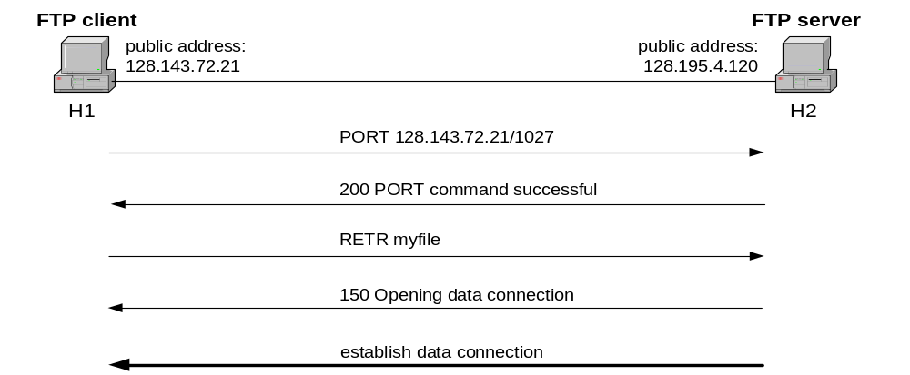
NAT and FTP
Normal FTP operation

Slide 18
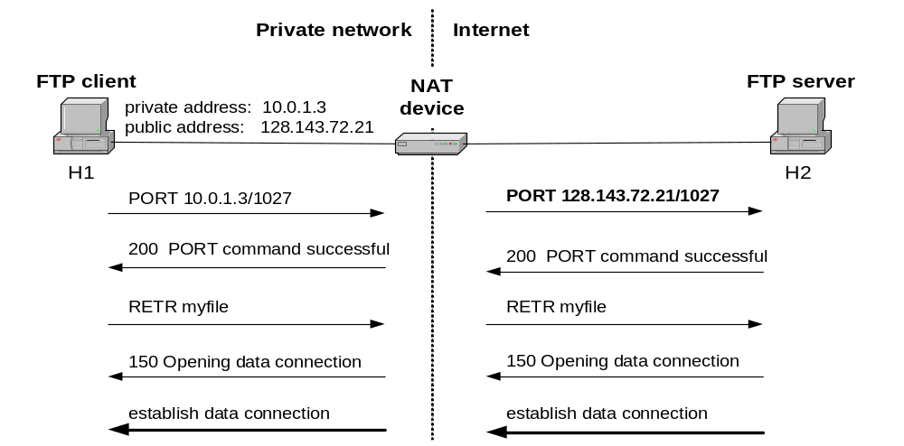
NAT and FTP
NAT device with FTP support

Slide 19
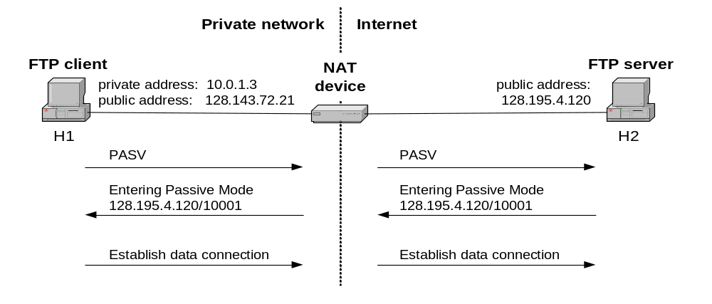
NAT and FTP
FTP in passive mode and NAT.

Slide 20
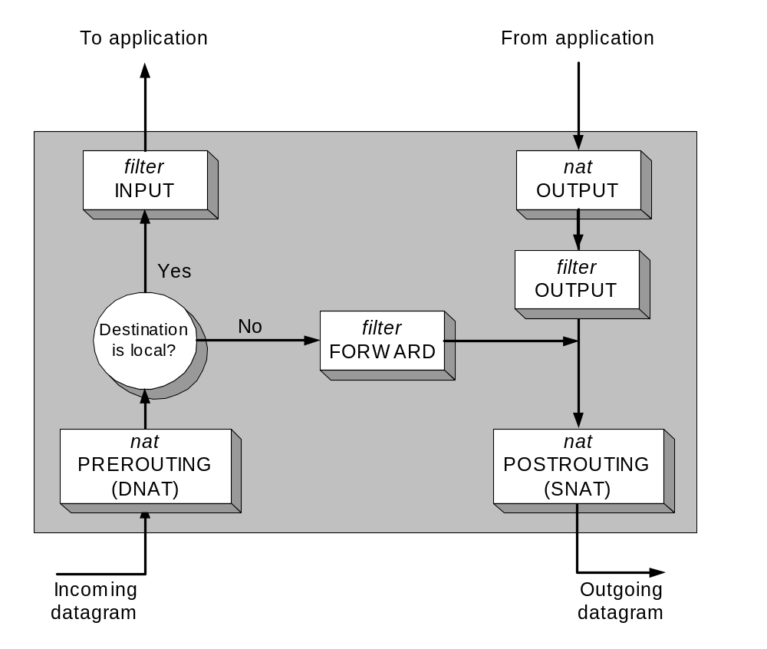
Configuring NAT in Linux
Linux uses the Netfilter/iptable package to add filtering rules to the IP module

Slide 21
Configuring NAT with iptable
First example:
iptables –t nat –A POSTROUTING –s 10.0.1.2
–j SNAT --to-source 128.143.71.21
Pooling of IP addresses:
iptables –t nat –A POSTROUTING –s 10.0.1.0/24
–j SNAT --to-source 128.128.71.0–128.143.71.30
ISP migration:
iptables –t nat –R POSTROUTING –s 10.0.1.0/24
–j SNAT --to-source 128.195.4.0–128.195.4.254
IP masquerading:
iptables –t nat –A POSTROUTING –s 10.0.1.0/24
–o eth1 –j MASQUERADE
Load balancing:
iptables -t nat -A PREROUTING -i eth1 -j DNAT --to-destination 10.0.1.2-10.0.1.4

Slide 22
Dynamic Host Configuration Protocol (DHCP)

Slide 23
Dynamic Assignment of IP addresses
Dynamic assignment of IP addresses is desirable for several reasons:
  IP addresses are assigned on-demand
  Avoid manual IP configuration
  Support mobility of laptops

Slide 24
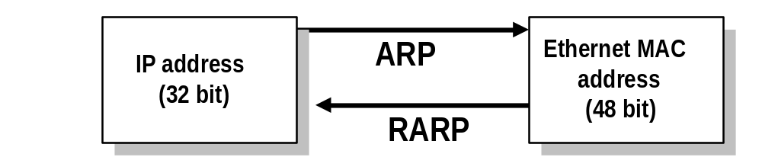
Solutions for dynamic assignment of IP addresses
Reverse Address Resolution Protocol (RARP)
  Works similar to ARP
  Broadcast a request for the IP address associated with a given MAC address
  RARP server responds with an IP address
  Only assigns IP address (not the default router and subnetmask)

Slide 25
BOOTP
BOOTstrap Protocol (BOOTP)
    From 1985
    Host can configure its IP parameters at boot time.
    3 services.
      IP address assignment.
      Detection of the IP address for a serving machine.
      The name of a file to be loaded and executed by the client machine (boot file name)
  Not only assign IP address, but also default router, network mask, etc.
  Sent as UDP messages (UDP Port 67 (server) and 68 (host))
  Use limited broadcast address (255.255.255.255):
    These addresses are never forwarded

